Slide 1

Cross-Sentiment Analysis of Literature Sources using BERT
Capstone Project Phase A 23-2-R6
Authors:
Omer Asus 205923717
Alon Modin 316567585
Advisors:
Dr. Renata Avros
Prof. Zeev Volkovich

Slide 2
Content
Problem Definition
BERT
CNN
Encoders
Working Flow
Graphical User Interface
GUI Test Plan
UML Diagram

Slide 3
Problem Definition

Slide 4
Identifying Text Writers through Writing Style Analysis
Introduction :
Objective: Identify text writers by analyzing their unique authorship style
Methodology: Analyze tweet-like texts using sentiment analysis methodology

Slide 5
Identifying Text Writers through Writing Style Analysis
Methodology :
Challenge: Applying of sentiment analysis approach to differentiating authorships
Solution: Employ a BERT-based aspect-level sentiment analysis algorithm
Benefits of BERT: Contextual understanding and capturing language nuances

Slide 6
Identifying Text Writers through Writing Style Analysis
Dataset and Model Development:
Translate long texts to short as tweets batches
Exploit BERT as the backbone for discerning and classifying tweet-like text
Potential Applications: Author profiling, opinion mining, and social media analysis

Slide 7
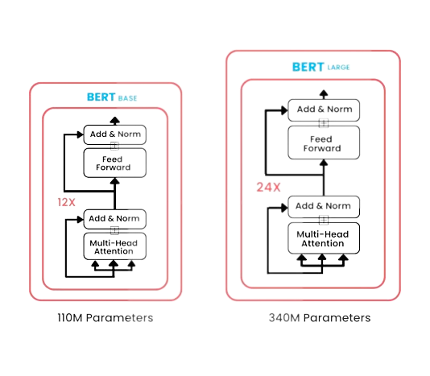
BERT(Bidirectional Encoder Representations from Transformers) Base and Large model

Slide 8
BERT: Advancing Natural Language Processing
Introduction :
BERT is a transformer trained on huge datasets
BERT is constructed to treat NLP problems such as sentiment analysis, text generation, translation between languages, etc.
Significance: Revolutionized deep learning in natural language processing (NLP)
Key feature: Capturing contextual information bidirectionally

Slide 9
BERT: Advancing Natural Language Processing
Pre-training Phase:
Masked Language Model:
Model: Randomly masking tokens and predicting them based on context
Learning relationships between words within a sentence
Next Sentence Prediction:
Understanding sentence-level relationships
Capturing dependencies between sentences

Slide 10
BERT: Advancing Natural Language Processing
Fine-tuning and Transfer Learning:
Fine-tuning BERT for specific tasks:
Adding task-specific layers and optimizing on task-specific datasets
Examples: Text classification, named entity recognition, question answering
Knowledge transfer:
Leveraging learned representations for downstream tasks
Achieving state-of-the-art performance in NLP benchmarks

Slide 11
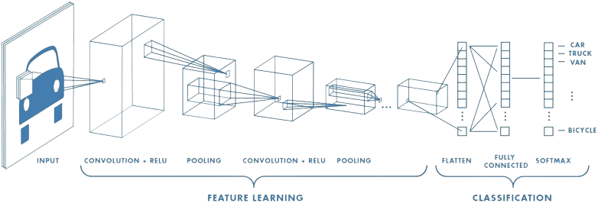
CNN

Slide 12
Convolutional Neural Networks (CNNs) for Image Processing
Introduction :
Purpose: Process and analyze images
Composition: Convolutional layers, pooling layers, fully connected layers
Advantages: Automatic feature extraction, handling large-scale data

Slide 13
Convolutional Neural Networks (CNNs) for Image Processing
Functionality :
Convolutional Layers:
Extract features from images
Capture patterns and spatial information
Pooling Layers:
Reduce spatial dimensions, preserve important information
Achieve spatial invariance and robustness
Fully Connected Layers:
Connect extracted features to a classifier
Perform high-level reasoning and classification

Slide 14
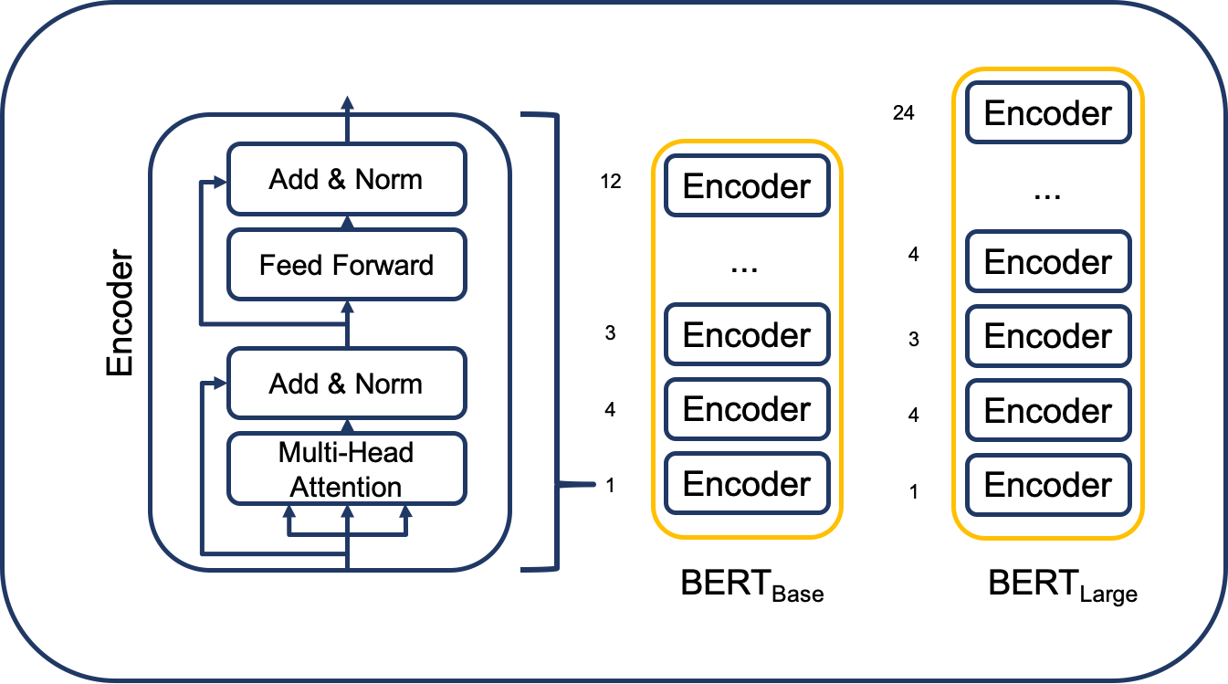
Encoders

Slide 15
Encoders in Deep Learning
Definition: Encoders transform input data into compressed representations.
Purpose: Reduce complexity and extract important information.
How it works:
Input Data
Extract Features
Capture Patterns
Encoders are utilized in both small and large BERT models.
The encoders in BERT can be fine-tuned aiming to adapt to a specific task.

Slide 16
Working Flow of the Project

Slide 17
The main idea is to employ the sentiment analysis methodology.
From our perspective, each text is divided into small, like a tweet, portions.
Sentiment analysis determines the underlying sentiment expressed within a small text piece.
In our connotation, “positive” and “negative” means different authorships.
To deal with the problem, we intend to employ a BERT-based aspect-level sentiment analysis algorithm for cross-domain text.
BERT, a pre-trained language model, is known for its ability to comprehend contextual information and capture intricate language nuances.

Slide 18
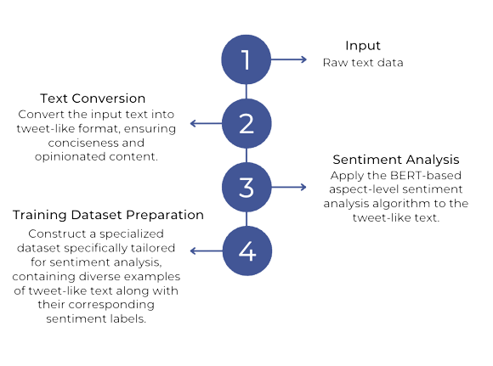

Slide 19
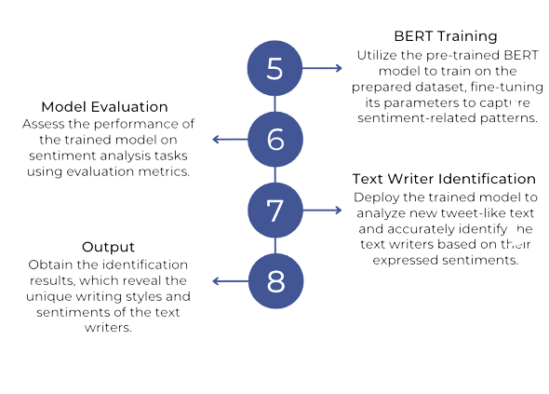

Slide 20
Graphical User Interface

Slide 21
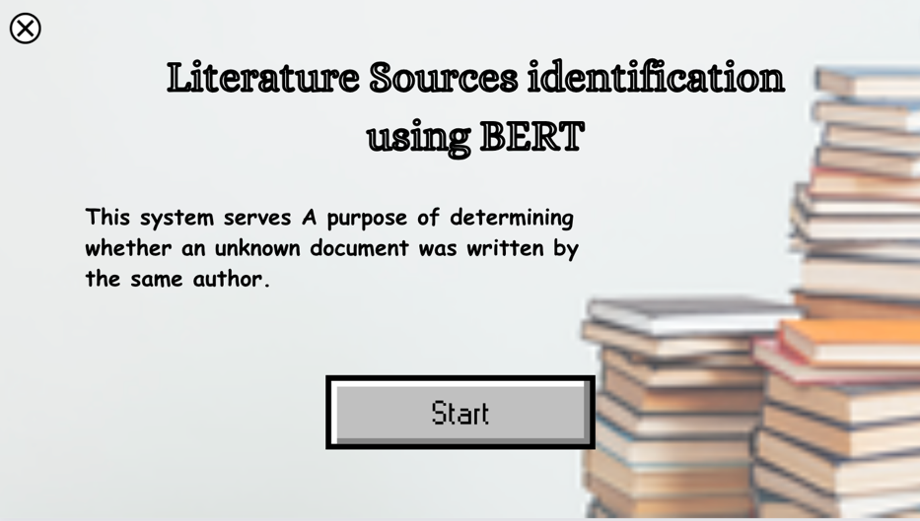
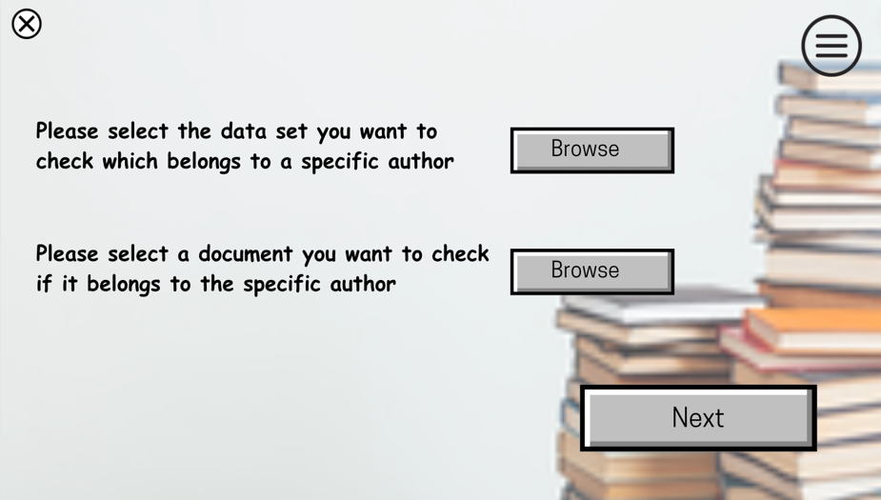
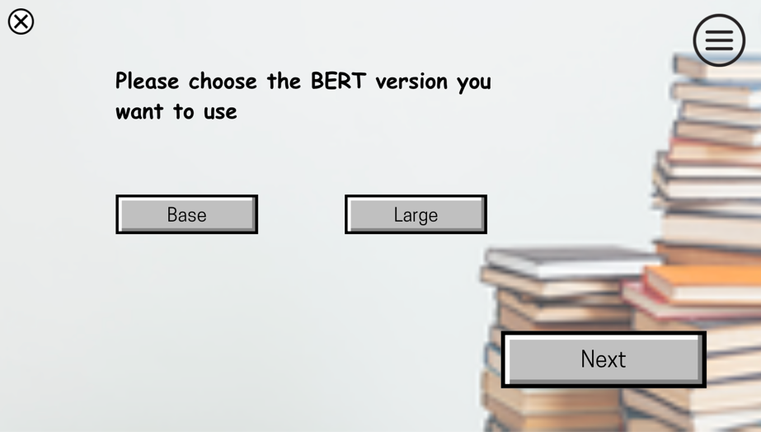
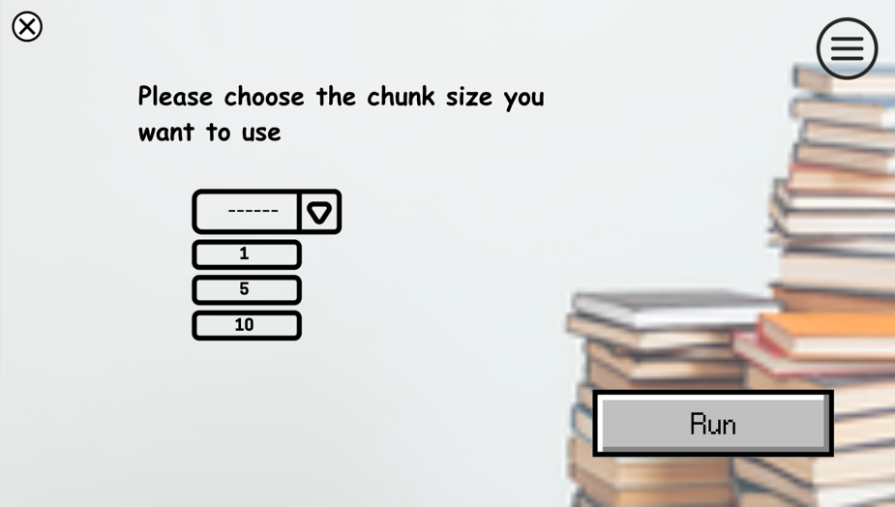

Slide 22
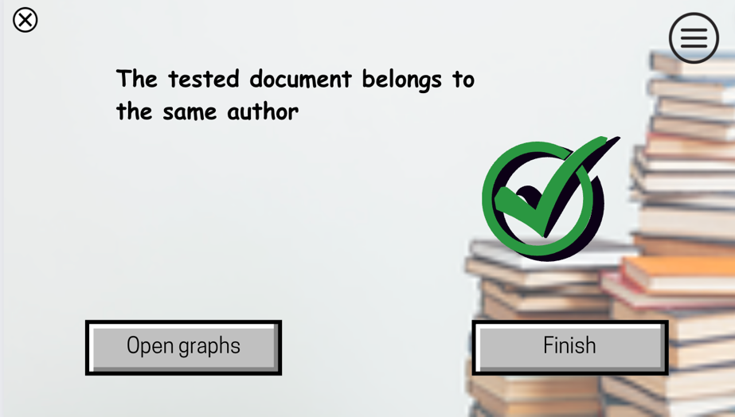
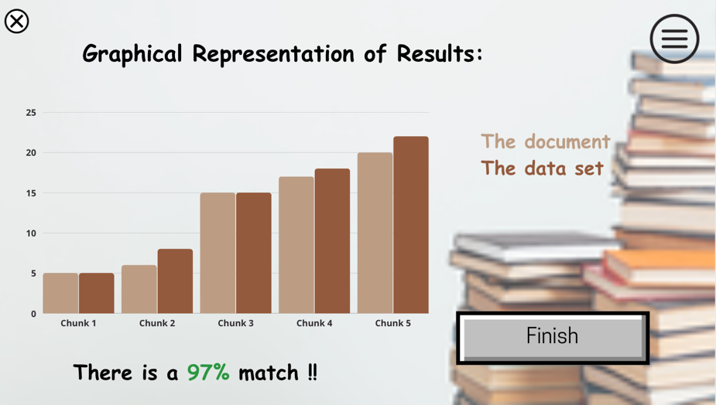
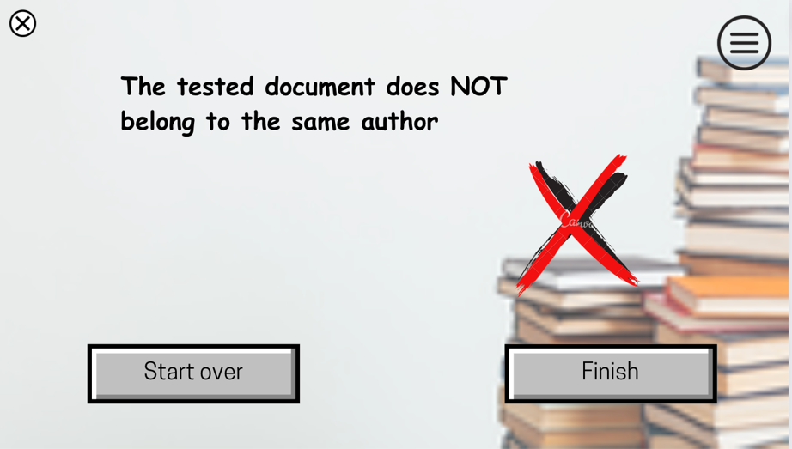

Slide 23
GUI Test Plan

Slide 24
Test | Test module | Test description | Expected result
1 | Home window | Click exit (“X”) | Close the window
2 | Home window | Click “Start” | Open the Browser window
3 | Browser window | Click exit (“X”) | Close the window
4 | Browser window | Click Menu button | Display a drop-down menu with relevant options for selection. Selecting an option should trigger the corresponding action
5 | Browser window | Click the first “Browse” button | Open a file selection dialog for the user to browse and select the author data set file
6 | Browser window | Click the second “Browse“ button | Open a file selection dialog for the user to browse and select the text file.
7 | Browser window | Click “Next” button | Enable the Next button only when two files (a text file and an author data set file) are selected. Clicking Next should proceed to the BERT size window
8 | BERT size window | Click exit (“X”) | Close the window
9 | BERT size window | Click Menu button | Display a drop-down menu with relevant options for selection. Selecting an option should trigger the corresponding action
10 | BERT size window | Click “Base” Button | Selecting the Base button should enable it, and the Large button should remain unselected
11 | BERT size window | Click “Large” Button | Selecting the Large button should enable it, and the Base button should remain unselected
12 | BERT size window | Click “Next” button | Enable the Next button after selecting either the Base or Large button. Clicking Next should proceed to the Chunk size window
13 | Chunk size window | Click exit (“X”) | Close the window
14 | Chunk size window | Click Menu button | Display a drop-down menu with relevant options for selection. Selecting an option should trigger the corresponding action
15 | Chunk size window | Select Chunk Size from Drop List | The user should be able to select a desired chunk size from the drop-down list.
16 | Chunk size window | Click “Run” button | After selecting the chunk size and clicking the run button. If successful, a "Test Succeeded" window will open, otherwise, a "Test Failed" window will open.
17 | Test Succeeded window | Click exit (“X”) | Close the window
18 | Test Succeeded window | Click Menu button | Display a drop-down menu with relevant options for selection. Selecting an option should trigger the corresponding action
19 | Test Succeeded window | Click “Open graphs” button | Clicking the Open Graphs button open the Graph window
20 | Test Succeeded window | Click “Finish” button | Clicking the Finish button should close the current window and terminate the application
21 | Graph window | Click exit (“X”) | Close the window
22 | Graph window | Click Menu button | Display a drop-down menu with relevant options for selection. Selecting an option should trigger the corresponding action
23 | Graph window | Click “Finish” button | Clicking the Finish button should close the current window and terminate the application and pop-up save graph option
24 | Test Failed window | Click exit (“X”) | Close the window
25 | Test Failed window | Click Menu button | Display a drop-down menu with relevant options for selection. Selecting an option should trigger the corresponding action
26 | Test Failed window | Click “Start over” button | Clicking the Start Over button open "BERT Size" window, resetting any progress made in the current window.
27 | Test Failed window | Click “Finish” button | Clicking the Finish button should close the current window and terminate the application

Slide 25
UML Diagram

Slide 26
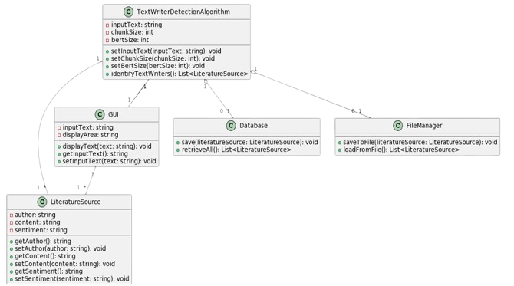

Slide 27


